Slide 1
Memory manangement in Java
Nguyen Duc Kien

Slide 2
Outline
Overview
Stack memory
Heap memory
Reference types
Garbage collection
String in memory

Slide 3
Overview
1

Slide 4
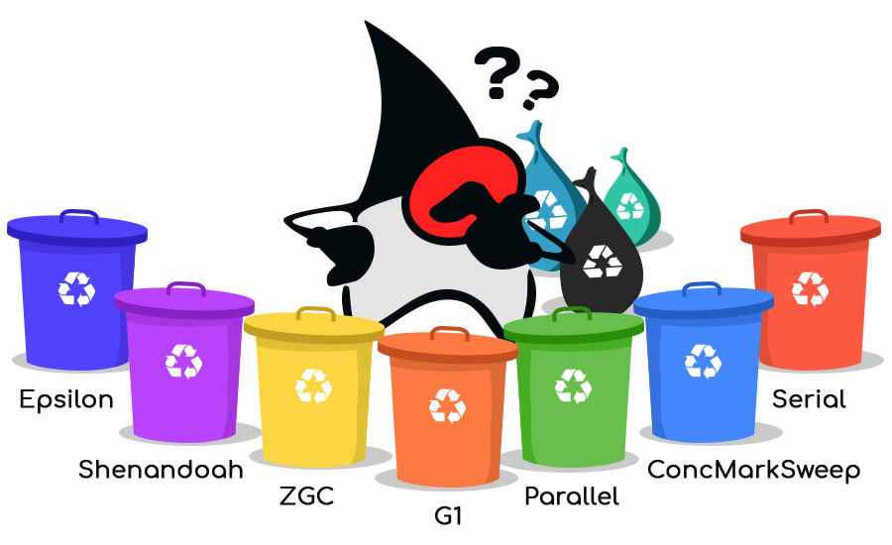
Unlike C++, Java has automatic memory management, a nice and quiet garbage collector that works in the background to clean up the unused objects and free up some memory.
While this process is automatic in Java, it does not guarantee that all objects has been deleted by Garbage collector because it’s not eligible for garbage collecting even if we’re no longer using them ⇨ This might cause the OutOfMemoryError.
🡺 So knowing how memory actually works in Java is important, as it gives you the advantage of writing high-performance and optimized applications.
Notes:
Sửa lại ảnh

Slide 5
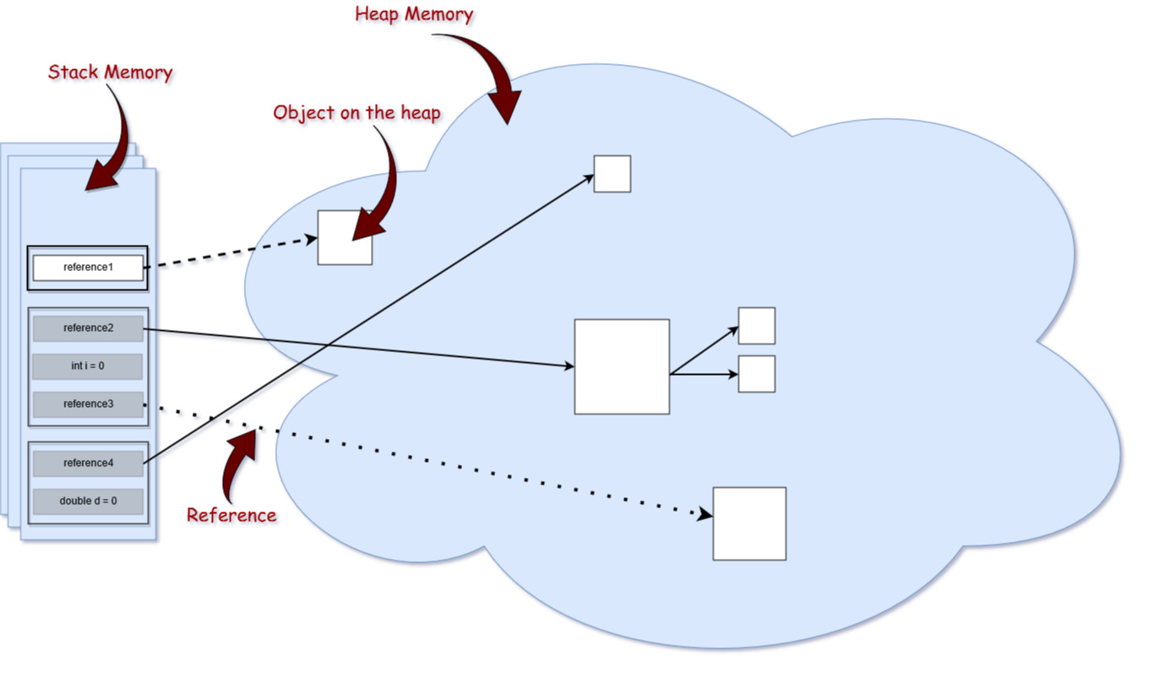
There 2 part of run-time memory which really important to handle: Stack and Heap.
Heap memory is larger than the stack memory.
Relationship between stack and heap
Notes:
Sửa lại ảnh

Slide 6
Stack Memory
2

Slide 7
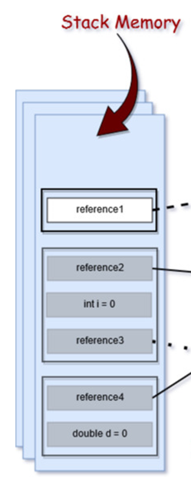
Responsible for holding references to heap objects and for storing value types (also known in Java as primitive types).
Variables on the stack have a certain visibility, also called scope. Only objects from the active scope are used.
For example: Assuming that we do not have any global scope variables (fields), and only local variables.
⇨ If the compiler executes a method’s body, it can access only objects from the stack that are within the method’s body and cannot access by other local variables
Once the method completes and returns, the top of the stack pops out.
Notes:
Sửa lại ảnh

Slide 8
Heap memory
3

Slide 9
This part of memory stores the actual object in memory. Those are referenced by the variables from the stack.
The new keyword is responsible for ensuring that there is enough free space on heap, creating an object of the StringBuilder type in memory and referring to it via the “builder” reference, which goes on the stack.
Only one heap memory for each running JVM process and it shares memory regardless of how many threads are running.
Example of creating an object
Notes:
Sửa lại ảnh

Slide 10
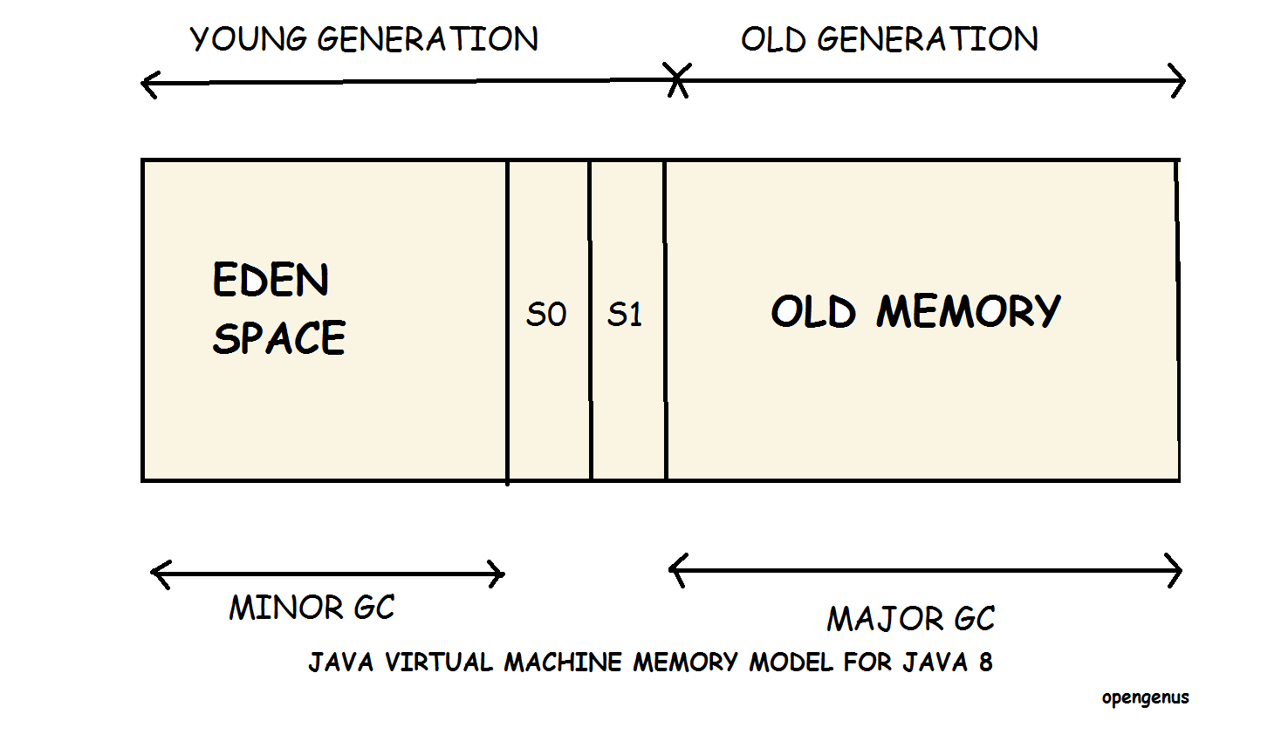
The heap itself is divided into a 2 parts: Young and Old generation.
Each of them has its own garbage collector which facilitates the process of garbage collection.
The maximum stack and the heap sizes are not predefined — this depends on the running machine.
Young generation
Young generation is the memory space where all the new objects are created.
Garbage collection in the Young Generation memory space is called Minor Garbage Collector.
Young Generation is divided into three parts namely Eden Memory space and two Survivor Memory spaces which facilitates for Minor garbage collector at working.
Minor garbage collection checks the survivor objects and move them to the other survivor space. Thus, one of the survivor space is always empty.
Objects that are survived after many cycles of garbage collection, are moved to the Old generation memory space.
Old generation
Old Generation memory contains the objects that are long lived and survived after many rounds of Minor garbage collection.
Garbage collection in the Old Generation memory space is called Major garbage collector and usually takes much longer than Minor garbage collection.
When Old generation memory space is filled with objects, major garbage collector will be performed.
Number of Major garbage collections less than number of Minor garbage collections, so the time taken by Major also more than Minor.

Slide 11
Reference Types
4

Slide 12
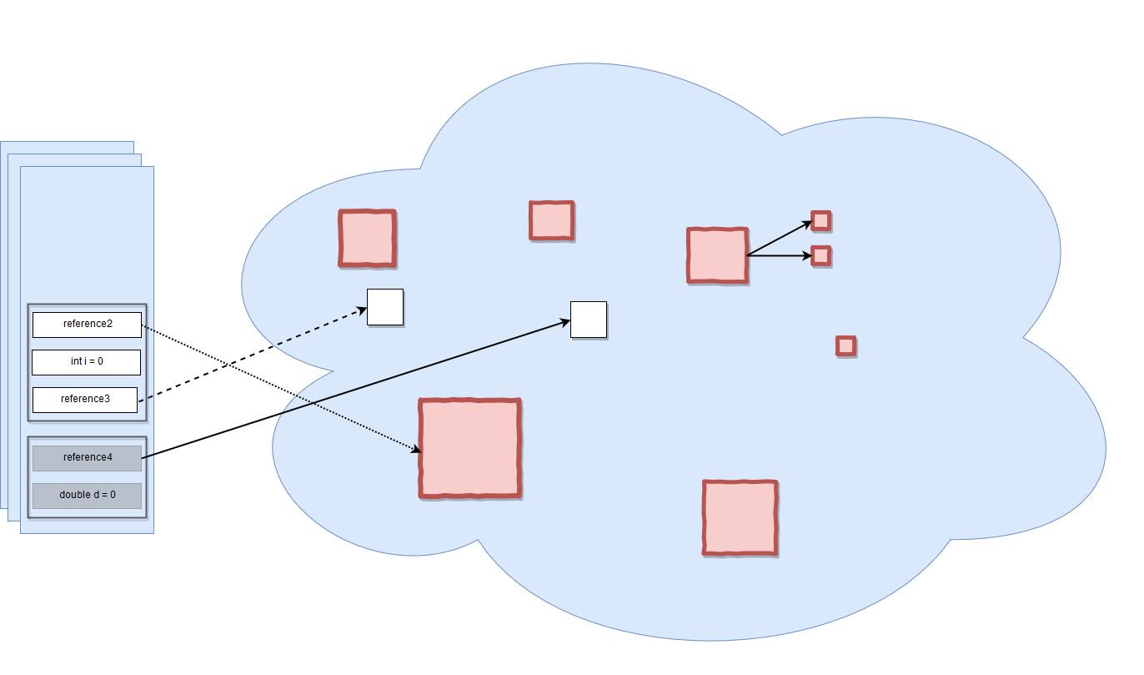
The arrows representing the references to the objects from the heap are actually of different types as 4 different types of references: strong, weak, soft, and phantom references.
The difference between the types of references is that the objects on the heap they refer to are eligible for garbage collecting under the different criteria
Notes:
Sửa lại ảnh

Slide 13
Strong Reference: These are the most popular reference types that we all are used to like the example StringBuilder. The object on the heap which is not garbage collected while there is a strong reference pointing to it.
Weak Reference: weak reference is most likely not survive after the next garbage collection process. A weak reference is created as follows:
Soft Reference are going to be garbage collected only when your application is running low on memory. Java guarantees that all soft referenced objects are cleaned up before it throws an Out Of Memory Error. A soft reference is created as follows:
Phantom reference: Used to schedule post-mortem cleanup actions, since we know for sure that objects are no longer alive. Used only sur with a reference queue, since the .get() method of such references will always return null. These types of references are considered preferable to finalizers.

Slide 14
Garbage Collection
5

Slide 15
Depending on the type of reference that a variable from the stack holds to an object from the heap, at a certain point in time, that object becomes eligible for the garbage collector.
This process is triggered automatically by Java, and it is up to Java when and whether or not to start this process. We could explicitly call System.gc() to garbage objects but it’s not advised.
It is actually an expensive process. When the garbage collector runs, all threads in your application are paused.

Slide 16
Step of garbage collection
YOUNG MEMORY
OLD MEMORY
EDEN
S0
S1
OBJ
OBJ
OBJ
OBJ
OBJ
OBJ
OBJ
OBJ
OBJ
OBJ

Slide 17
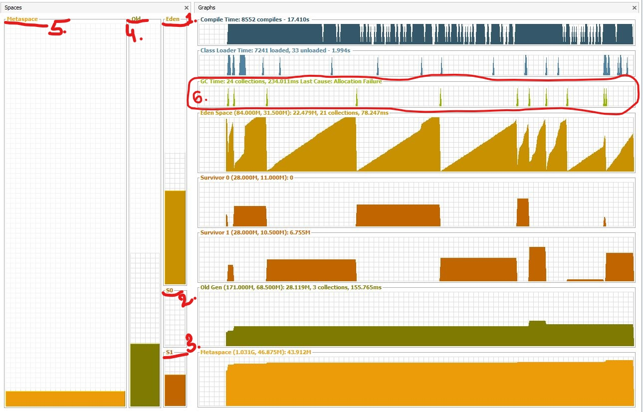

Slide 18
The Metaspace which is changed from PERM since Java 8, is used to store the meta data about your loaded classes in the JVM.
From those Garbage Collection working process, the leak memory problem usually happened in old generation when major garbage collector cannot reduce objects. And it would take the form of java.lang.OutOfMemoryError: PermGen space.

Slide 19
String In Memory
6

Slide 20
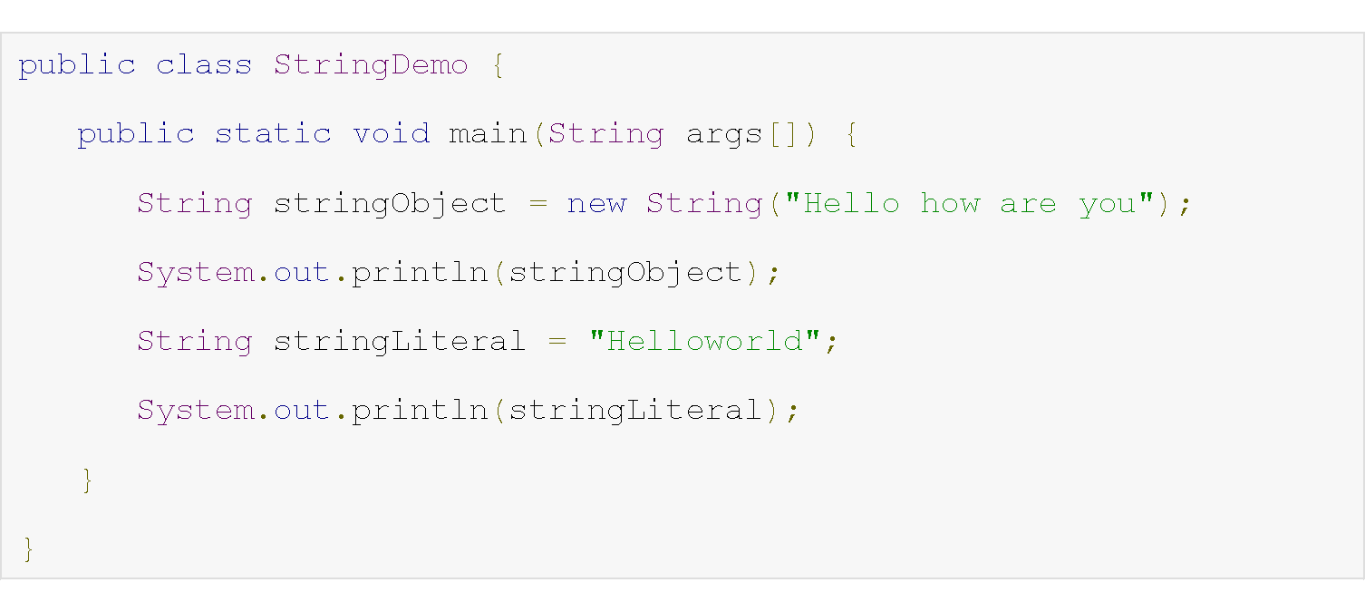
String could be created either by using the new keyword (like any other object) or, by assigning value to the literal (like any other primitive data type). Like the below example:
new String(“Hello how are you”) stores on heap memory normally like every object. But, object “Helloworld” (also call string literal) stores on another heap memory ’s area, called String Constant pool.

Slide 21


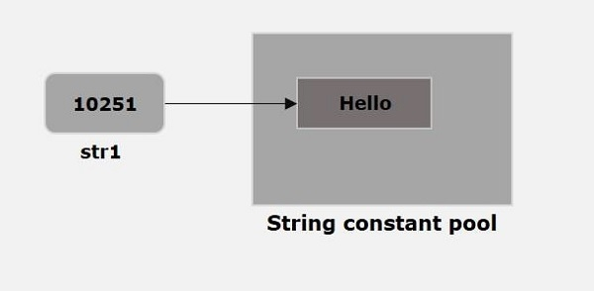
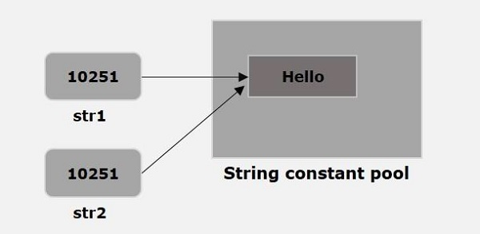
JVM creates a String object with the given value in a String constant pool.
And whenever we try to create another String as the code below. JVM verifies whether any String object with the same value exists in the String constant pool, if so, instead of creating a new object JVM assigns the reference of existing object to the new variable.

Slide 22
Thanks!
Any questions ?

